Slide 1
Working with IDLE

Slide 2
IDLE
IDLE is an interface for writing and running Python programs.
It does not require a separate installation but is automatically installed with Python.
Unless you are already familiar with another IDE, it is recommended that you use IDLE.

Slide 3
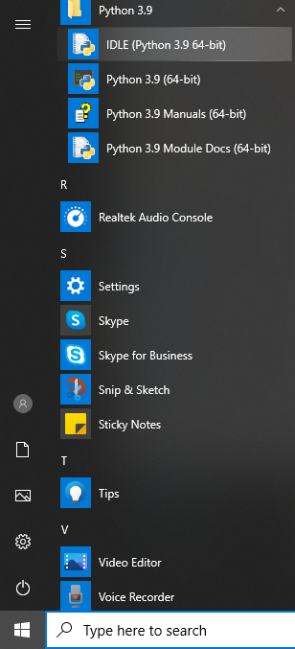
Opening IDLE
On Windows, after installing
Python, IDLE should appear
as shown.
On Mac, it should appear at
its equivalent place.

Slide 4
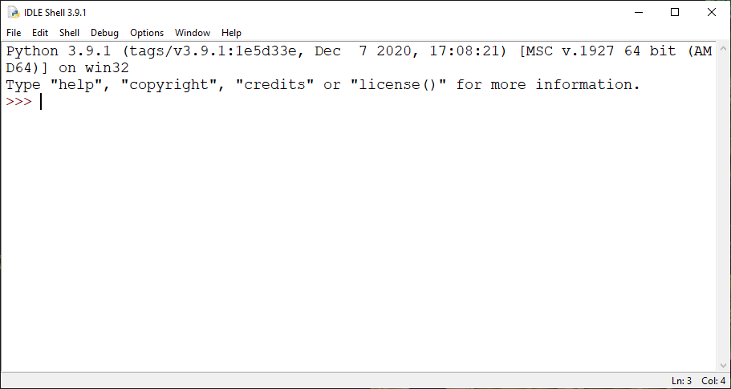
Opening IDLE
This is IDLE’s “prompt”, waiting for your command.
Type any Python statement and press enter.

Slide 5
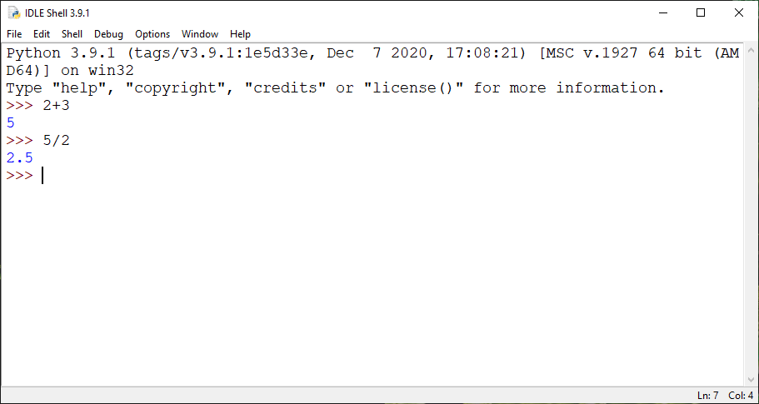
Using IDLE

Slide 6
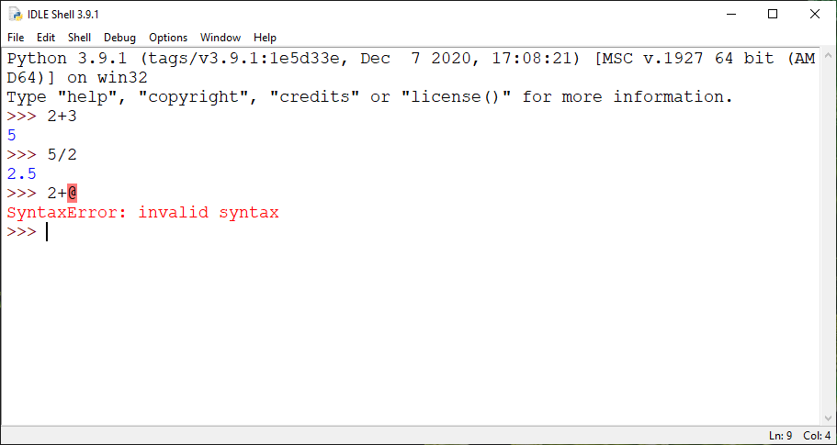
Using IDLE
An incorrect statement will always
give a red error.

Slide 7
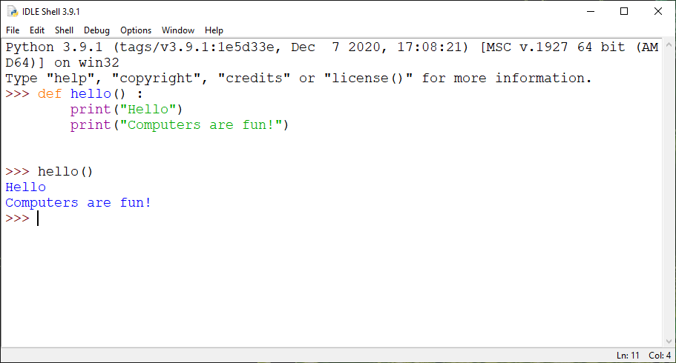
Using IDLE
IDLE helps in
automatically
putting indentation
and colors.
Press enter
twice to end the
function definition.
Defining a function “hello”
Executing the function “hello”

Slide 8
Using IDLE
Once you exit (by File → Exit or by clicking top right corner “x” or by typing “control d”), IDLE forgets everything you had typed or defined.
Opening IDLE next time will not remember the “hello” function. You will need to redefine it.

Slide 9
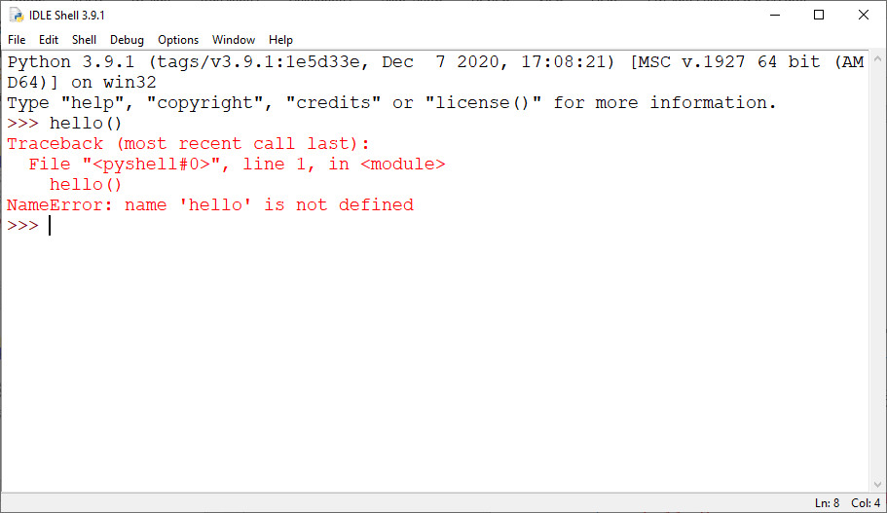
Using IDLE

Slide 10
Writing Programs in a File
Hence programs should be saved in a file if you intend to reuse them.
What you saw in the previous slides was IDLE’s interpreter
It takes commands and executes them
IDLE also comes with an editor in which you can write and save your program and later execute it on IDLE’s interpreter.

Slide 11
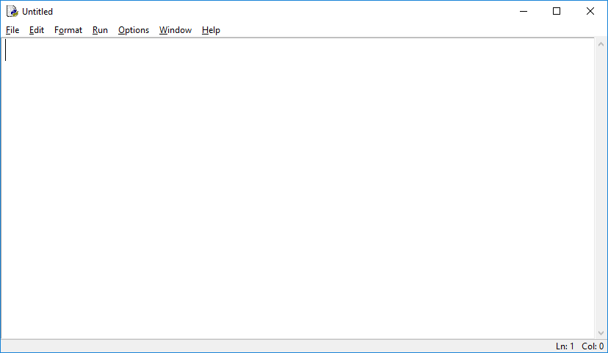
IDLE’s Editor
From IDLE’s interpreter “File→New File” opens IDLE’s editor which looks like this (note that there is no prompt “>>>”):

Slide 12
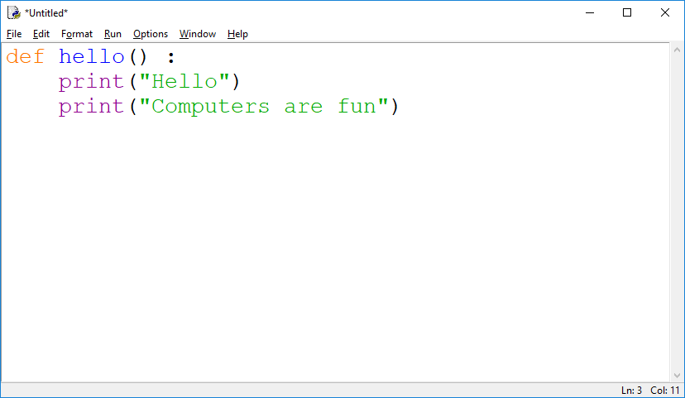
IDLE’s Editor
Write your program in the editor. It will still help with indentation and show colors.
Note that pressing enter twice will not do anything other than go to two lines next (again note that this is not an interpreter).

Slide 13
IDLE’s Editor
To save the file use “File→Save” or “control S”.
By default it will try to save the file in the Python’s installation folder (more on that later) and ask you for a file name.
Give a file name, say “myHello”, and save it in the Python’s installation folder (the default location it shows).
It automatically adds “.py” extension to the file (meant for Python programs), you don’t need to add it to the name.
You can close the editor if you no longer intend to edit the program.

Slide 14
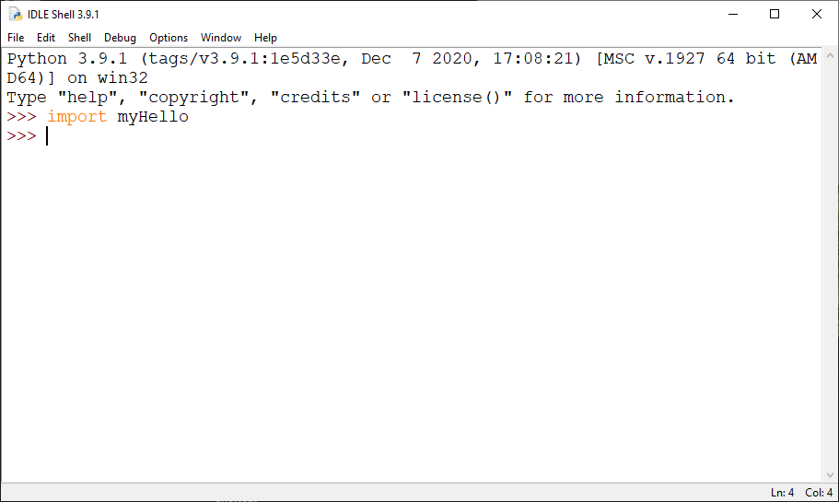
Importing a Program
Once you have written a program through IDLE’s editor, you can run it on IDLE interpreter by importing it.
Type import filename (without .py extension) on the prompt
If there was any incorrect statement in the program it would give red error upon importing the program (none here).

Slide 15
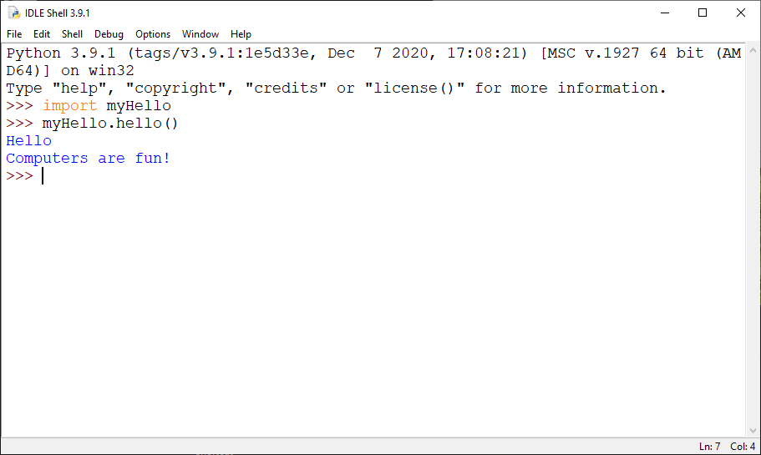
Running Program
Type filename.function_name (e.g. myHello.hello()) to run the function you wrote in the file. Note you always give “()” to run a function (more on it later in the course).

Slide 16
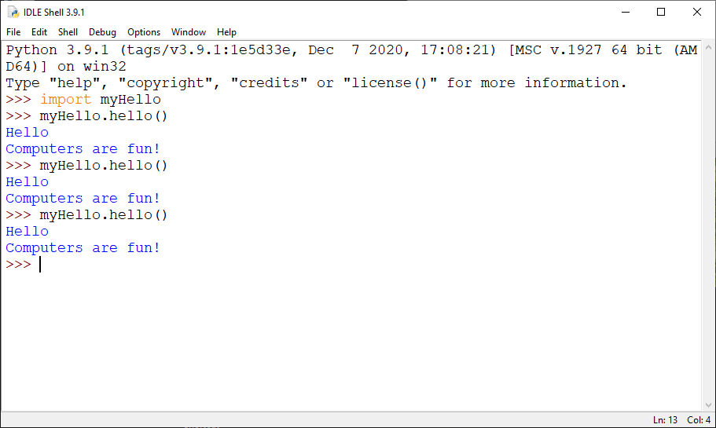
Running Program
You can run the program multiple times. If you exit the interpreter, you will have to import the file again (but you don’t need to write the function again)

Slide 17

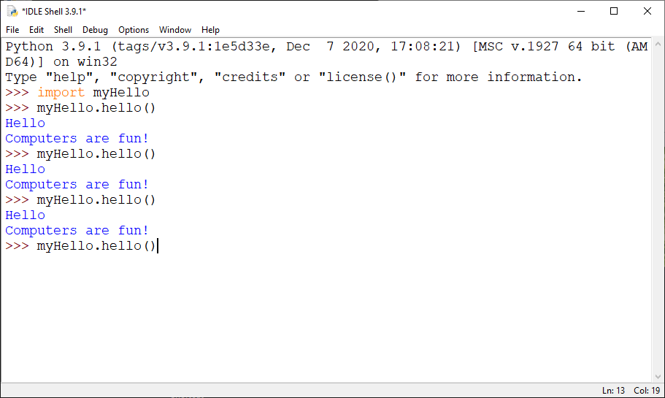
A tip for giving an earlier command
If you want to give an earlier command again then you don’t need to type it again. Bring the mouse cursor at the end of any one of the earlier commands and press enter, the command will be re-written at the prompt.

Slide 18
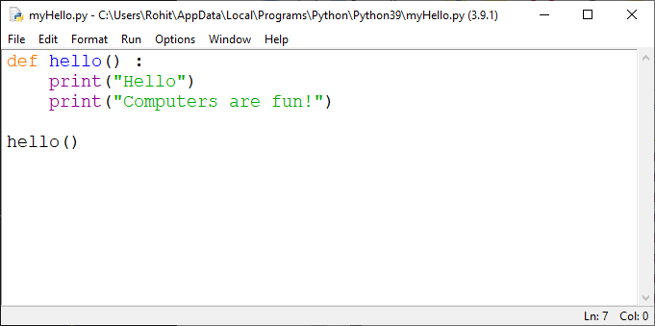
To run the program immediately upon importing
If one calls a function at the end of a file, it will execute upon importing (assuming no red errors) the file.
Note that the indentation should be aligned
“outside” the function definition.

Slide 19
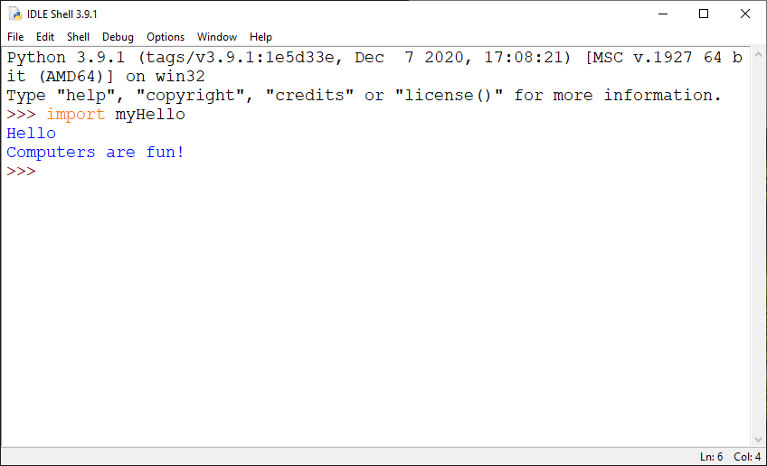
To run the program immediately upon importing
Note that the function runs upon importing the file
(i.e. no need to do myHello.hello()).
However, to run it again you will have to type myHello.hello().

Slide 20
Changing Python Program File
You an always reopen the saved program and edit it.
File→ Open from the interpreter or locate the file in the folder and right-click → Edit with IDLE
Note: The file is saved as plain text (but with .py extension instead of .txt extension) which you can also edit using NotePad or WordPad, however then you will not get help with indentation or see colors. Hence it is best to edit programs using IDLE’s editor.
Every time you change the program (and save it) you need to import it again to run it.
And this new import should be after restarting IDLE or restarting its shell (Shell → Restart Shell or “Control F6”.) Otherwise it will still run the old program.

Slide 21
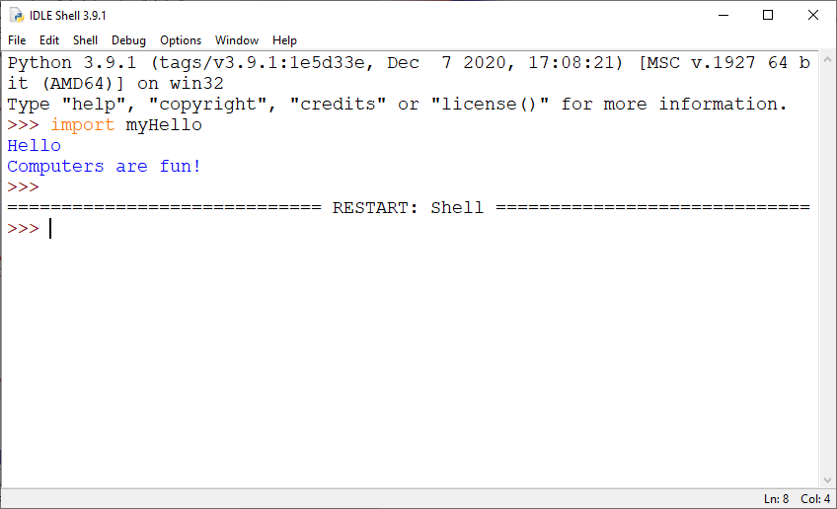
After Changing Python Program File
Shell → Restart Shell or “Control F6”

Slide 22
Python Installation Folder
IDLE’s editor saves it by default in a Python’s folder (shown/chosen during installation):
The default location (if not changed during installation) for Windows is: C:\Users\<user>\AppData\Local\Programs\Python\Python39
(You will need to make hidden folders visible:
Right-click on Windows Start button then right-click on “Settings”
Search for “File Explorer Options” in “Settings” and change it under the “View” tab; see the next slide)
Good idea to make a shortcut for that folder on Desktop etc.
When importing a module, IDLE looks for the file in that folder

Slide 23
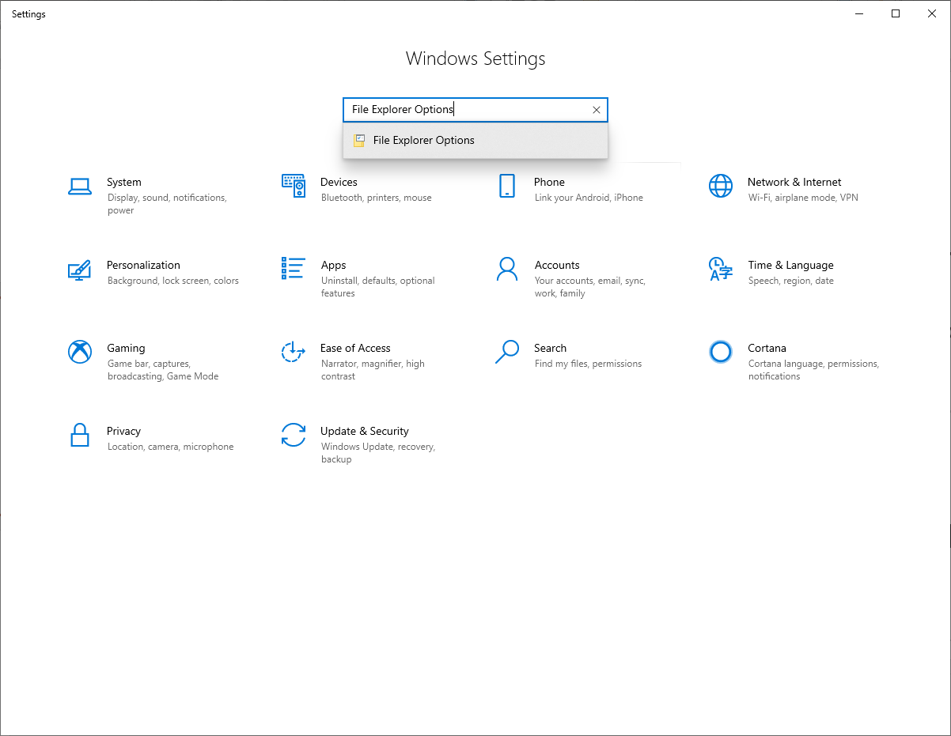
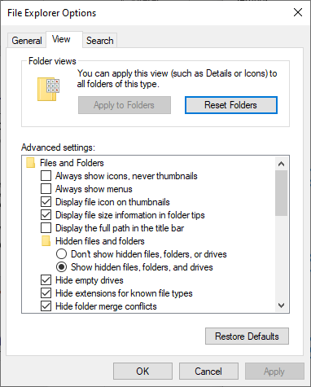
Making Hidden Folders Visible

Slide 24
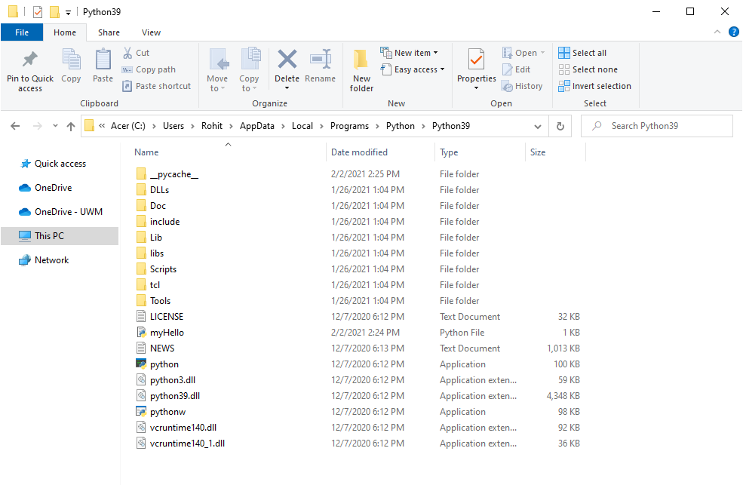
Python Installation Folder
Saved file
You can open a saved file in IDLE’s editor by “right click ->Edit with IDLE”.
But to run the program, you need to import it from IDLE’s interpreter.

Slide 25
Python Installation Folder
Please save files in the Python’s installation folder because that makes it easy to import it.
If you have mac, then please find out where is its Python installation folder.

Slide 26
Editor vs Interpreter
Please be very clear about the difference between the editor and the interpreter.
The editor is for writing programs. It has no prompt.
The interpreter is for running programs (or statements) on the prompt.
Editor
Interpreter

Slide 27
Editor vs Interpreter
Important: For all assignments, you need to submit the program file written in the editor which runs correctly upon importing on the interpreter.
Note that the interpreter also lets you save (File → Save) but what it saves is the work done on the prompt which is not a python program that can run upon importing (for example, it will give errors about “>>>” which cannot be in a Python program).
It is a common mistake to submit the work saved on the interpreter instead of the program written in the editor

